Slide 1
Python

Slide 2
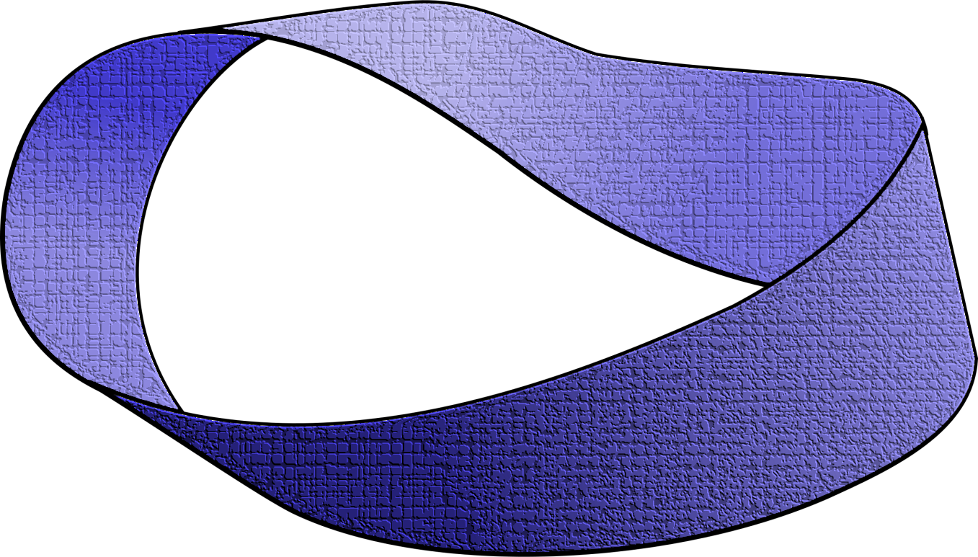
Programming using Python
Loops

Slide 3
Printing Multiplication Table
2 | X | 1 | = | 2
2 | X | 2 | = | 4
2 | X | 3 | = | 6
2 | X | 4 | = | 8
2 | X | 5 | = | 10
2 | X | 6 | = | 12
2 | X | 7 | = | 14
2 | X | 8 | = | 16
2 | X | 9 | = | 18
2 | X | 10 | = | 20

Slide 4
Program…
n = int(input('Enter a number: '))
print (n, 'X', 1, '=', n*1)
print (n, 'X', 2, '=', n*2)
print (n, 'X', 3, '=', n*3)
print (n, 'X', 4, '=', n*4)
print (n, 'X', 5, '=', n*5)
print (n, 'X', 6, '=', n*6)
….
Too much
repetition!
Can I avoid
it?

Slide 5
Printing Multiplication Table
Loop Entry
Input n
i = 1
Loop Exit
i <=10
TRUE
FALSE
Print n X i = n*i
i = i+1
Stop
Loop

Slide 6
Printing Multiplication Table
Input n
i = 1
n = int(input('n=? '))
i = 1
while (i <= 10) :
print (n ,'X', i, '=', n*i)
i = i + 1
print ('done‘)
TRUE
i <=10
FALSE
Print n x i = ni
i = i+1
Stop

Slide 7
While Statement
while (expression):
S1
S2
FALSE
expression
TRUE
S1
S2
Evaluate expression
If TRUE then
execute statement1
goto step 1.
If FALSE then execute statement2.

Slide 8
For loop in Python
General form
for variable in sequence:
stmt

Slide 9
For Loop
Print the sum of the reciprocals of the first 100 natural numbers.
rsum=0.0# the reciprocal sum
# the for loop
for i in range(1,101):
rsum = rsum + 1.0/i
print ('sum is', rsum)

Slide 10
range
range(s, e, d)
generates the list:
[s, s+d, s+2*d, …, s+k*d]
where s+k*d < e <= s+(k+1)*d
range(s, e) is equivalent to range(s, e, 1)
range(e) is equivalent to range(0, e)
Exercise: What if d is negative? Use python interpreter to find out.

Slide 11
Quiz
What will be the output of the following program
# print all odd numbers < 10
i = 1
while i <= 10:
if i%2==0: # even
continue
print (i, end=‘ ‘)
i = i+1

Slide 12
Continue and Update Expr
Make sure continue does not bypass update-expression for while loops
# print all odd numbers < 10
i = 1
while i <= 10:
if i%2==0: # even
continue
print (i, end=‘ ‘)
i = i+1
i is not incremented
when even number
encountered.
Infinite loop!!

Slide 13
Practice Problem…..
Read a number of 5 digits as 12345 and then find the squared sum of each digit as 1**2+2**2+3**2+4**2+5**2.
Read a number of 5 digits as 12345 and then find the reverse of it as 54321.
Fibonacci numbers are the numbers of an interesting sequence in which each number is equal to the sum of the previous two terms as Fi = F(i-1) + F(i-2), where Fi refers to the ith fibonacci number. It is also given that first two terms of the fibonacci numbers are equal to 1, i.e, F1=F2=1
so, F3 = F2+F1 = 1+1 =2
F4 = F3+F2 = 2+1 =3
F5 = F4+F3 = 3+2 =5
Write a program to find the first N fibonacci numbers of user defined N.
A k-digits number is called Armstrong number if it is equal to the sum of kth power of its digits as 153 = 1**3 + 5**3 + 3**3 = 1 + 125 + 27 = 153 and 1634 = 1**4 + 6**4 + 3**4 + 4**4.
Generate all possible Armstrong numbers between 0 to 5000.

Slide 14
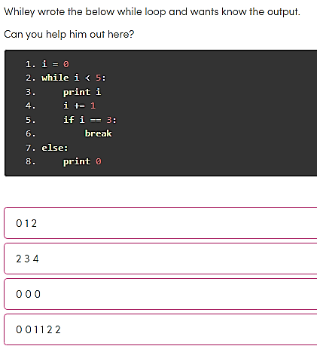
Notes:
0 1 2

Slide 15
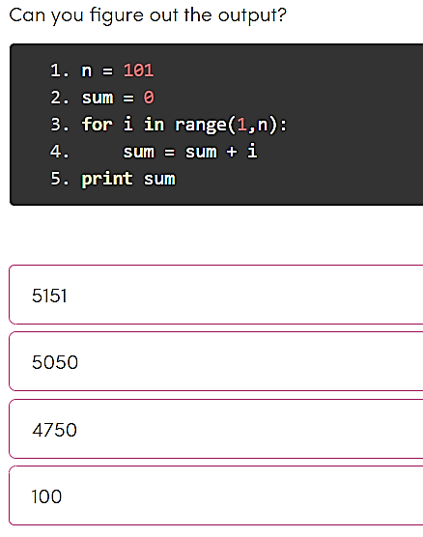
Notes:
5050

Slide 16
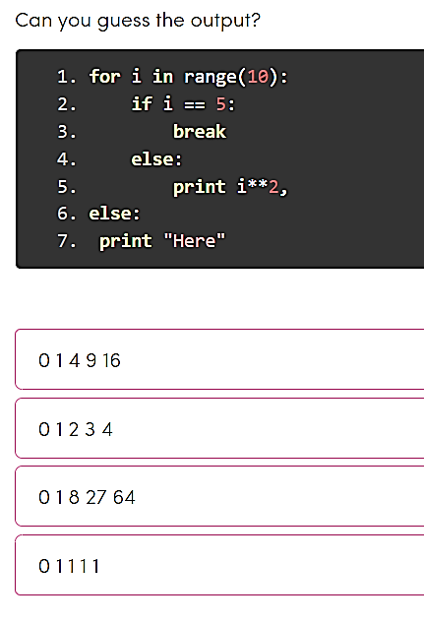
Notes:
Option 1

Slide 17
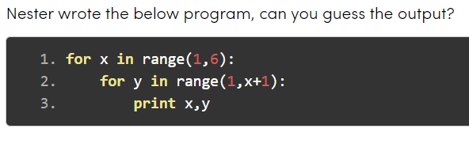
A. No output
B. 1 2 3 4 5 6 7 8 9 ….. Till infinity
C. 2 2 3 3 3 4 4 4 4 5 5 5 5 5
D 1 1 2 1 2 2 3 1 3 2 3 3 . . . 5 5
Notes:
D

Slide 18
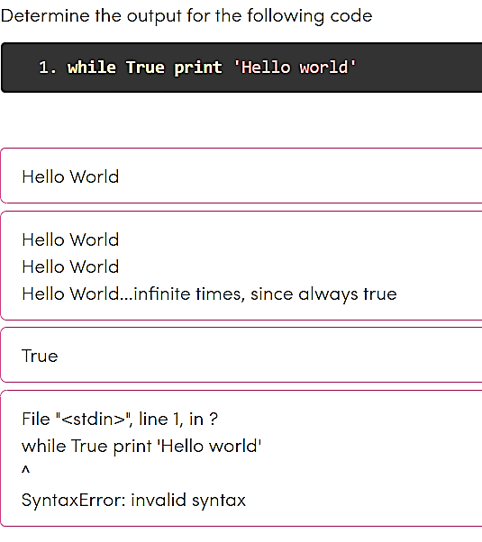
Notes:
B

Slide 19
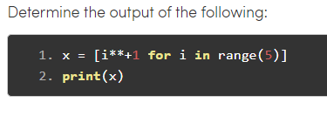

Slide 20
Determine the output:
def func(array):
for num in array:
if num%2 == 0:
print(num)
break # Case1: Break is called, so 'else' wouldn't be executed.
else: # Case 2: 'else' executed since break is not called
print("No call for Break. Else is executed")
print("1st Case:")
a = [2]
func(a)
print("2nd Case:")
a = [1]
func(a)
Notes:
1st Case:
2
2nd Case:
No call for Break. Else is executed

Slide 21
Programming using Python
functions

Slide 22
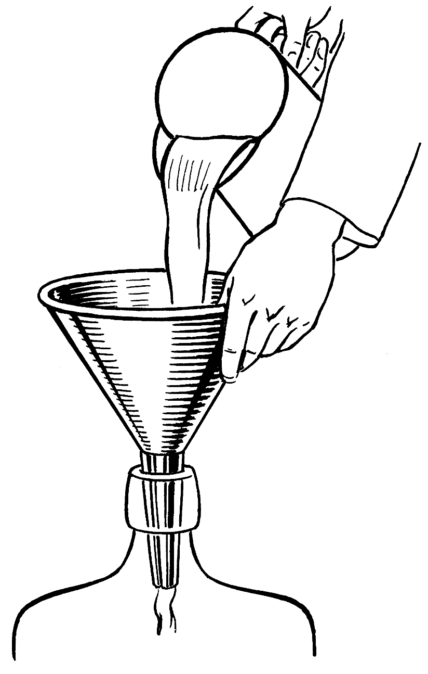
Parts of a function
Input
f
Output

Slide 23
def max (a, b):
‘’’returns maximum among a and b’’’
if (a > b):
return a
else:
return b
keyword
2 arguments
a and b
(formal args)
Function Name
x = max(6, 4)
Body of thefunction,
indented w.r.t the
def keyword
Call to the function.
Actual args are 6 and 4.
Documentation comment
(docstring), type
help <function-name>
on prompt to get help for the function

Slide 24
def max (a, b):
‘‘‘returns maximum among a and b’’’
if (a > b):
return a
else:
return b
In[3] : help(max)
Help on function max in module __main__:
max(a, b)
returns maximum among a and b

Slide 25
Keyword Arguments
def printName(first, last, initials) :
if initials:
print (first[0] + '. ' + last[0] + '.')
else:
print (first, last)
Note use of [0] to get the first character of a string.
Call | Output
printName('Acads', 'Institute', False) | Acads Institute
printName('Acads', 'Institute', True) | A. I.
printName(last='Institute', initials=False, first='Acads') | Acads Institute
printName('Acads', initials=True, last='Institute') | A. I.

Slide 26
Keyword Arguments
Parameter passing where formal is bound to actual using formal's name
Can mix keyword and non-keyword arguments
All non-keyword arguments precede keyword arguments in the call
Non-keyword arguments are matched by position (order is important)
Order of keyword arguments is not important

Slide 27
Default Values
def printName(first, last, initials=False) :
if initials:
print (first[0] + '. ' + last[0] + '.')
else:
print (first, last)
Note the use of “default” value
Call | Output
printName('Acads', 'Institute') | Acads Institute
printName(first='Acads', last='Institute', initials=True) | A. I.
printName(last='Institute', first='Acads') | Acads Institute
printName('Acads', last='Institute') | Acads Institute

Slide 28
Default Values
Allows user to call a function with fewer arguments
Useful when some argument has a fixed value for most of the calls
All arguments with default values must be at the end of argument list
non-default argument can not follow default argument

Slide 29
# A simple Python function to check
# whether x is even or odd
def evenOdd( x ):
if (x % 2 == 0):
print("even“)
else:
print("odd“)
# Driver code
evenOdd(2)
evenOdd(3)

Slide 30
Pass by Reference or pass by value?
One important thing to note is, in Python every variable name is a reference.
When we pass a variable to a function, a new reference to the object is created.
Parameter passing in Python is same as reference passing in Java.

Slide 31
# Here x is a new reference to same list lt
def myFun(x):
x[0] = 20
# Driver Code (Note that lst is modified
# after function call.
lt = [10, 11, 12, 13, 14, 15]
myFun(lt)
print(lt)
Output:
[20, 11, 12, 13, 14, 15]

Slide 32
When we pass a reference and change the received reference to something else, the connection between passed and received parameter is broken.
def myFun(x):
x = [20, 30, 40]
# Driver code
lst = [10, 11, 12, 13, 14, 15]
myFun(lst);
print(lst)
Output:[10, 11, 12, 13, 14, 15]

Slide 33
Globals
Globals allow functions to communicate with each other indirectly
Without parameter passing/return value
Convenient when two seemingly “far-apart” functions want to share data
No direct caller/callee relation
If a function has to update a global, it must re-declare the global variable with global keyword.

Slide 34
Globals
PI = 3.14
def perimeter(r):
return 2 * PI * r
def area(r):
return PI * r * r
def update_pi():
global PI
PI = 3.14159
>>> print(area (100))
31400.0
>>> print(perimeter(10))
62.800000000000004
>>> update_pi()
>>> print(area(100))
31415.999999999996
>>> print(perimeter(10))
62.832
defines PI to be of float type with value 3.14. PI can be used across functions. Any change to PI in update_pi will be visible to all due to the use of global.

Slide 35
Variable number of arguments:
We can have both normal and keyword variable number of arguments.
def myFun(*args):
for arg in args:
print (arg)
myFun(“Bootcamp”, “on”, “Python”, “Programming”)
Output:
Bootcamp
on
Python
Programming
def myFun(**kwargs):
for key, value in kwargs.items():
print ("%s == %s" %(key, value))
# Driver code
myFun(first =‘santosh', mid =‘kumar', last=‘verma’)
Output:
last == verma
mid == kumar
first == santosh

Slide 36
Anonymous functions/ Lambda Abstraction
Anonymous function means that a function is without a name.
As we already know that def keyword is used to define the normal functions
While, the lambda keyword is used to create anonymous functions. A lambda function can take any number of arguments but can only have one expression.
cube = lambda x: x*x*x
print(cube(7))
Output: 343
Note: It is as similar as inline functions in other programming language.
x = lambda a : a + 10 print(x(5))
Output: 15
x = lambda a, b, c : a + b + c print(x(5, 6, 2))
Output: 13

Slide 37
Recursion
Recursion is nothing but calling a function directly or in-directly and must terminate on a base criteria.
def factI(n): ‘’’Assumes n an int > 0 returns n!’’’ result = 1 while n>1: result = result * n n - = 1 return result | def factR(n): ‘’’Assumes n an int > 0 returns n!’’’ if n ==1: return n else: return n*factR(n-1)

Slide 38
Write a Python function to check whether a number is perfect or not.
According to Wikipedia : In number theory, a perfect number is a positive integer that is equal to the sum of its proper positive divisors, that is, the sum of its positive divisors excluding the number itself (also known as its aliquot sum). Equivalently, a perfect number is a number that is half the sum of all of its positive divisors (including itself). Example : The first perfect number is 6, because 1, 2, and 3 are its proper positive divisors, and 1 + 2 + 3 = 6. Equivalently, the number 6 is equal to half the sum of all its positive divisors: ( 1 + 2 + 3 + 6 ) / 2 = 6.
Write a Python function that checks whether a passed string is palindrome or not.
Write a Python function to check whether a string is a pangram or not.
Note : Pangrams are words or sentences containing every letter of the alphabet at least once. For example : "The quick brown fox jumps over the lazy dog"
Write a Python program that accepts a hyphen-separated sequence of words as input and prints the words in a hyphen-separated sequence after sorting them alphabetically.
Sample Items : green-red-yellow-black-white
Expected Result : black-green-red-white-yellow

Slide 39
Programming using Python Modules and Packages

Slide 40
Modules
As program gets longer, need to organize them for easier access and easier maintenance.
Reuse same functions across programs without copying its definition into each program.
Python allows putting definitions in a file
use them in a script or in an interactive instance of the interpreter
Such a file is called a module
definitions from a module can be imported into other modules or into the main module

Slide 41
Modules
A module is a file containing Python definitions and statements.
The file name is the module name with the suffix .py appended.
Within a module, the module’s name is available in the global variable __name__.

Slide 42
fibo.py as module
# Fibonacci numbers module
def fib(n): # write Fibonacci series up to n
a, b = 0, 1
while a < n:
print(a, end=' ')
a, b = b, a+b
print()
def fib2(n): # return Fibonacci series up to n
result = []
a, b = 0, 1
while a < n:
result.append(a)
a, b = b, a+b
return result
import fibo
>>> fibo.fib(1000)
0 1 1 2 3 5 8 13 21 34 55 89 144 233 377 610 987
>>>fibo.fib2(100)
[0, 1, 1, 2, 3, 5, 8, 13, 21, 34, 55, 89]
fibo.__name__
'fibo'

Slide 43
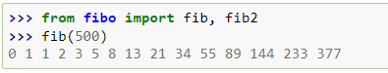
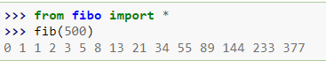
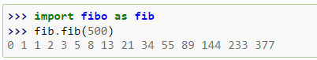
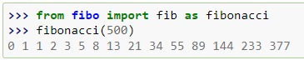
More about Module

Slide 44
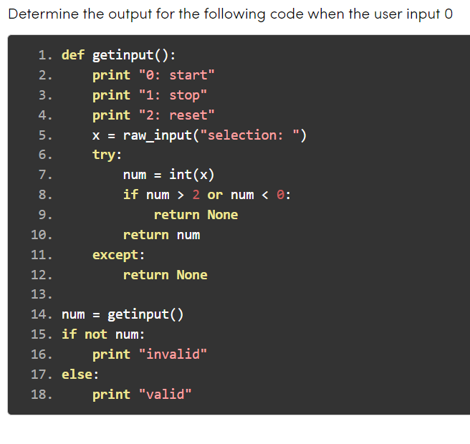
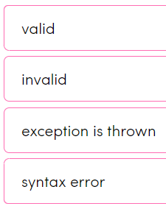
Notes:
Invalid

Slide 45
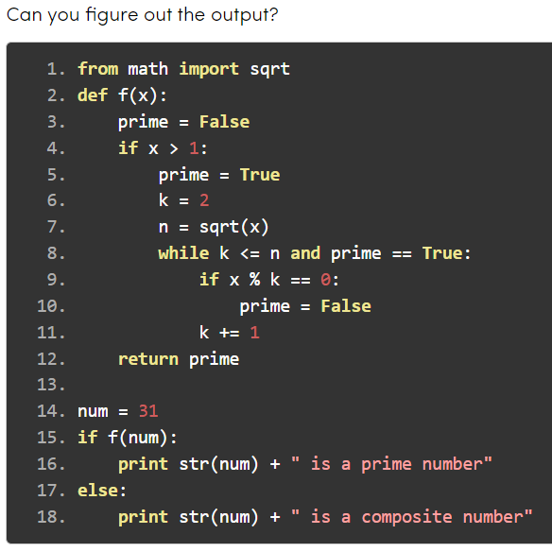
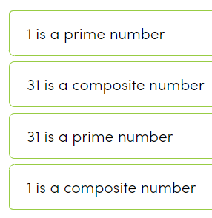
Notes:
C

Slide 46
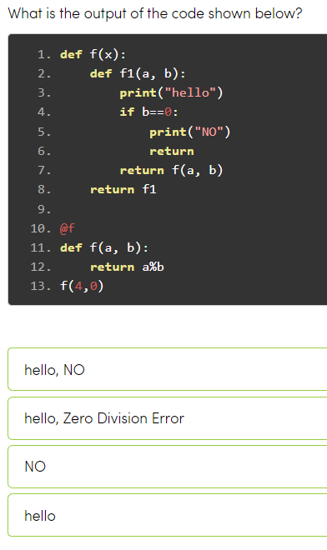
Notes:
1

Slide 47
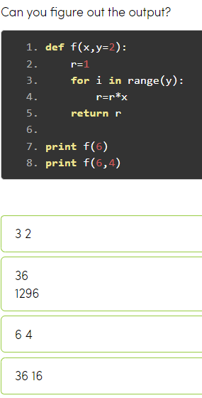
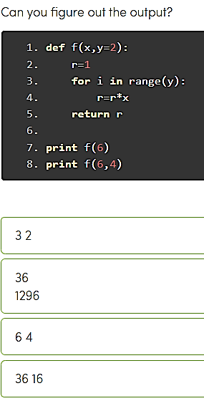
Notes:
B

Slide 48
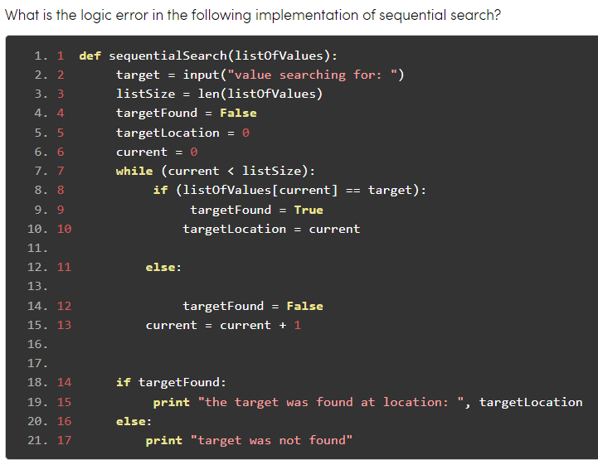
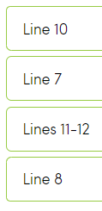
Notes:
C

Slide 49
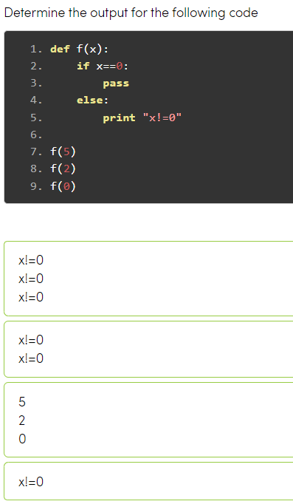
Notes:
B

Slide 50
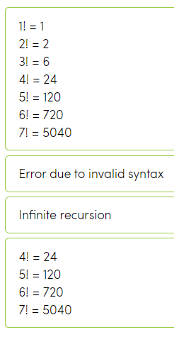
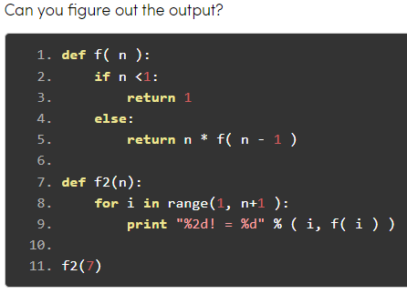
Notes:
A

Slide 51
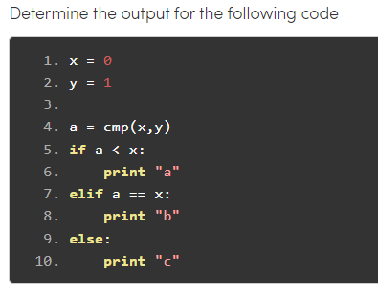
a
b
c
None
Notes:
A

Slide 52
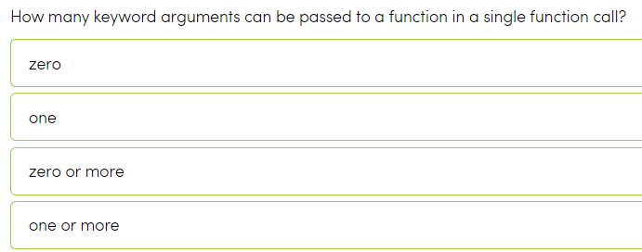
Notes:
C

Slide 53
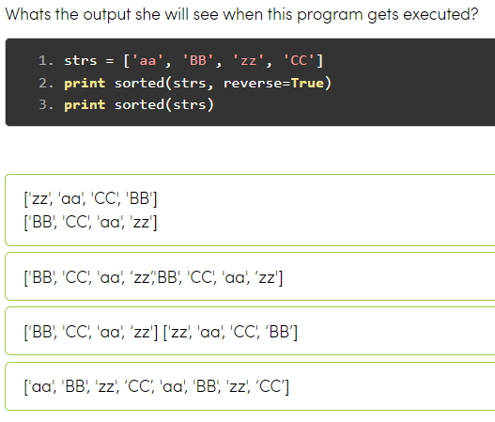
Notes:
A

Slide 54
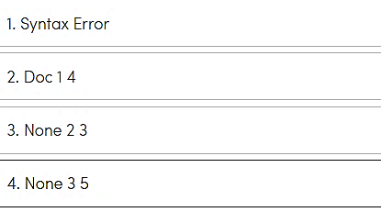
def f(*a):
r=0
for i in a:
r+=1
return r
print (f.__doc__,
f(1,2,3),
f(1,2,3,4,5))

Slide 55
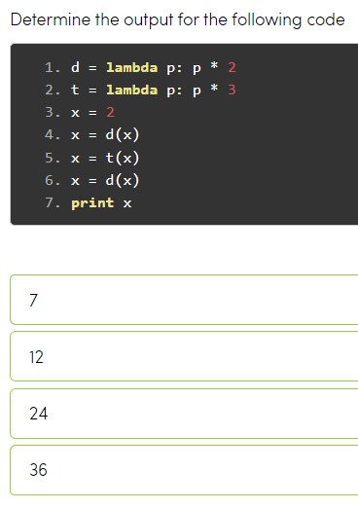
Notes:
C

Slide 56
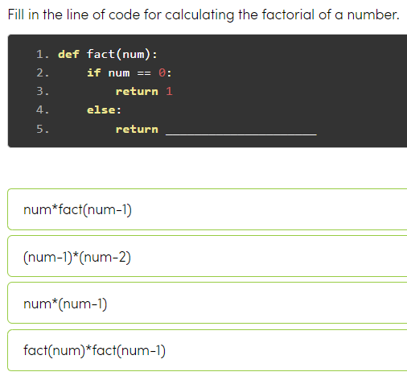
Notes:
A

Slide 57
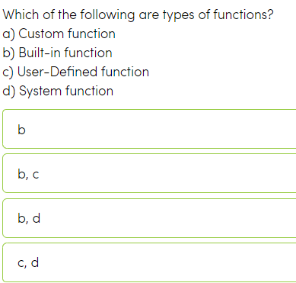
Notes:
B

Slide 58

Any question?

